Slide 1
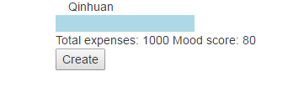
EyE Project Status
This is the List page.
Click the button “Create”, it will redirect to the add page.

Slide 2
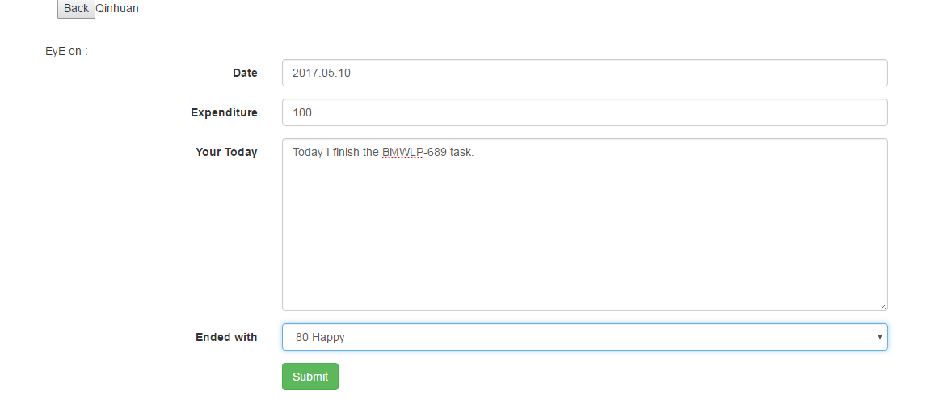
Add page
Input the information that it needs, and click the button “Submit”, it’ll save the data you input and then redirect to the list page.
If you click the button “Back”, it’ll redirect to list page without saving the data.

Slide 3
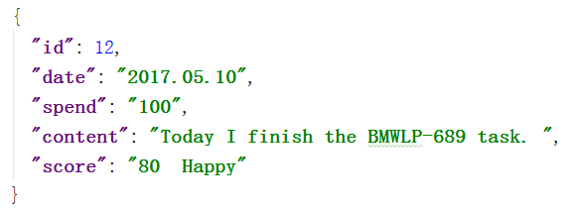
Save the data into json file
As you can see, the data you input in the add page have been saved into the json file.

Slide 4
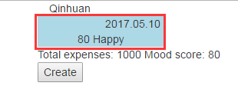
Back to list page after “Submit”
After “Submit”, it will redirect to list page, and show the latest one message that you input. (In fact, it’s what I want to optimize, the target is: update the list page with all of the data in json file, not show only one)

Slide 5
About the Css Style
I intend to consider the Css style finally.

Slide 6
Thank you !

